Slide 1
Introduction to CSS Cascading Style Sheets
Instructor: Manu Peethambar
E-mail: cm13055@umbc.edu
Telegram handle: @manupeethambar888
Slides: https://github.com/manupeethambar888/webdev

Slide 2
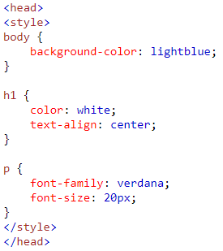
CSS introduction
CSS stands for Cascading Style Sheets
CSS is a language that describes the style of an HTML document.
CSS describes how HTML elements should be displayed.
CSS saves a lot of work. It can control the layout of multiple web pages all at once.
External stylesheets are stored in CSS files.

Slide 3
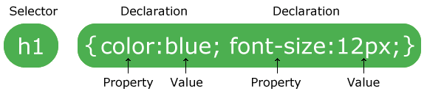
CSS Syntax
A CSS rule-set consists of a selector and a declaration block.
The selector points to the HTML element you want to style.
The declaration block contains one or more declarations separated by semicolons.
Each declaration includes a CSS property name and a value, separated by a colon.
A CSS declaration always ends with a semicolon, and declaration blocks are surrounded by curly braces.

Slide 4

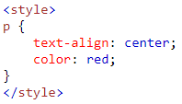
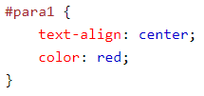
CSS Selectors
CSS selectors are used to "find" (or select) HTML elements based on their element name, id, class, attribute, and more.
The element Selector
The element selector selects elements based on the element name.
You can select all <p> elements on a page.
The id Selector
The id selector uses the id attribute of an HTML element to select a specific element.
The id of an element should be unique within a page, so the id selector is used to select one unique element!
To select an element with a specific id, write a hash (#) character, followed by the id of the element.
Note: An id name cannot start with a number!

Slide 5
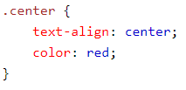



CSS Selectors
The class Selector
The class selector selects elements with a specific class attribute.
To select elements with a specific class, write a period (.) character, followed by the name of the class.
You can also specify that only specific HTML elements should be affected by a class.
HTML elements can also refer to more than one class.

Slide 6
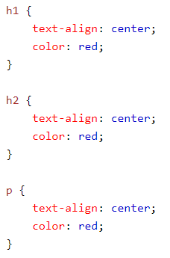
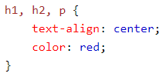
CSS Selectors
Group Selectors
If you have elements with the same style definitions.
It will be better to group the selectors, to minimize the code.

Slide 7

Three Ways to Insert CSS
1. External style sheet
With an external style sheet, you can change the look of an entire website by changing just one file!
Each page must include a reference to the external style sheet file inside the <link> element. The <link> element goes inside the <head> section.

Slide 8
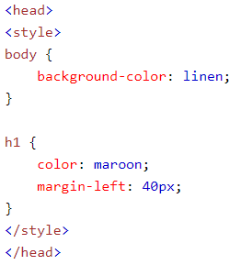
Three Ways to Insert CSS
2. Internal style sheet
An internal style sheet may be used if one single page has a unique style.
Internal styles are defined within the <style> element, inside the <head> section of an HTML page

Slide 9
Three Ways to Insert CSS
3. Inline styles
An inline style may be used to apply a unique style for a single element.
To use inline styles, add the style attribute to the relevant element. The style attribute can contain any CSS property.

Slide 10
Cascading Order
What style will be used when there is more than one style specified for an HTML element?
So, an inline style (inside a specific HTML element) has the highest priority, which means that it will override a style defined inside the <head> tag, or in an external style sheet, or a browser default value.
Inline style (inside an HTML element)
External and internal style sheets (in the head section)
Browser default

Slide 11



CSS Colors
Background Color
Text Color
Border Color
Color Values: https://www.w3schools.com/css/css_colors.asp
Color Picker: https://www.w3schools.com/colors/colors_picker.asp

Slide 12
CSS Backgrounds
The CSS background properties are used to define the background effects for elements.
CSS background properties:
background-color
background-image
background-repeat
background-attachment
background-position
Practice: https://www.w3schools.com/css/css_background.asp

Slide 13
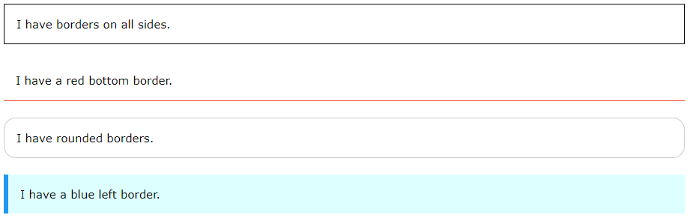
CSS Borders
The CSS border properties allow you to specify the style, width, and color of an element's border.
Practice: https://www.w3schools.com/css/css_border.asp

Slide 14
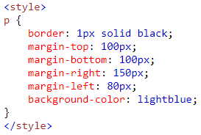

CSS Margins
The CSS margin properties are used to create space around elements, outside of any defined borders.
margin-top
margin-right
margin-bottom
margin-left
Practice: https://www.w3schools.com/css/css_margin.asp

Slide 15
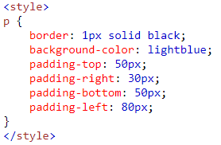
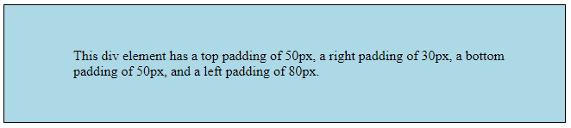
CSS Padding
The CSS padding properties are used to generate space around an element's content, inside of any defined borders.
padding-top
padding-right
padding-bottom
padding-left
Practice: https://www.w3schools.com/css/css_padding.asp

Slide 16

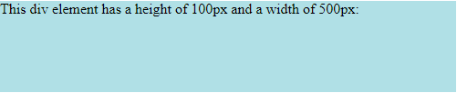
CSS Height and Width
The height and width properties are used to set the height and width of an element.

Slide 17

CSS Box Model
All HTML elements can be considered as boxes. In CSS, the term "box model" is used when talking about design and layout.
The CSS box model is essentially a box that wraps around every HTML element. It consists of: margins, borders, padding, and the actual content

Slide 18
Assignment 3 due – 6/28/2018
Create a sample html file.
Go to the next 3 slides for the questions.
Save this as “assignment3.html” in your repository “Assignments_yourname”.
Commit and push the changes to the repository.

Slide 19
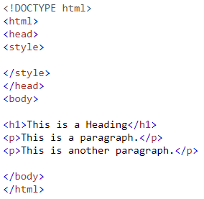
Assignment 3 due – 6/28/2018
a. Change the color of all <p> elements to "red".

Slide 20
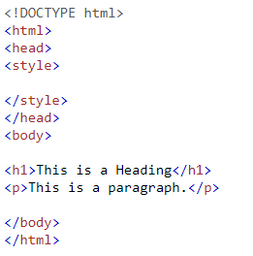
Assignment 3 due – 6/28/2018
b. Set a "4px", "dotted" border for <p>.

Slide 21
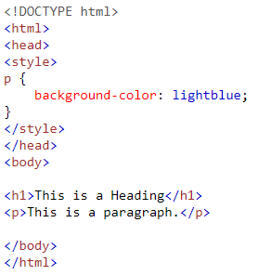
Assignment 3 due – 6/28/2018
c. Set the top padding of <p> to "30px"

